Slide 1


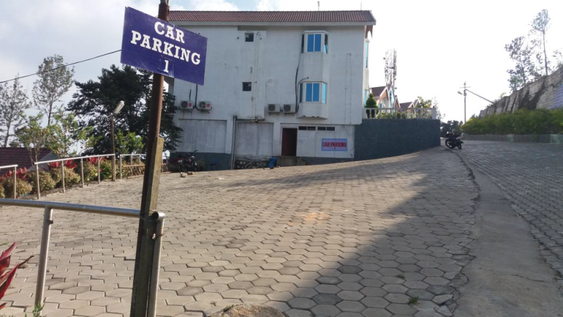
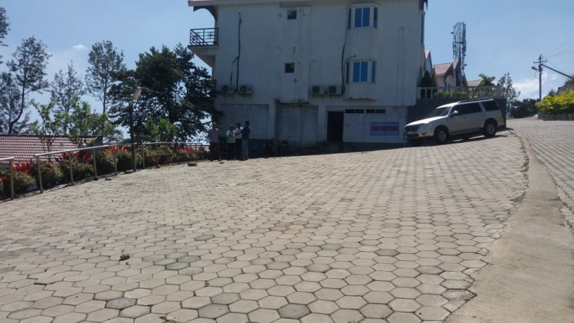
VACANT LAND
VL - 001
Location of Property | YERCAUD
Total area of Plot | 5224 sq.ft
Constructed area | NA
Year of construction | NA
Current market value | Rs. 78.35 lacs

Slide 2
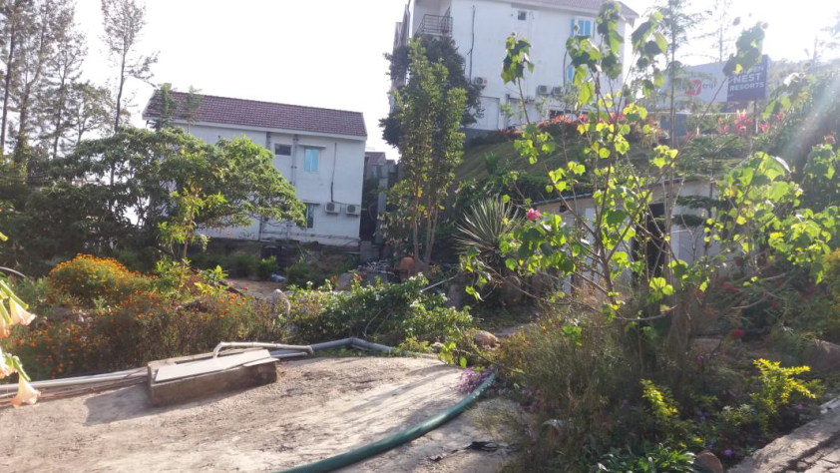
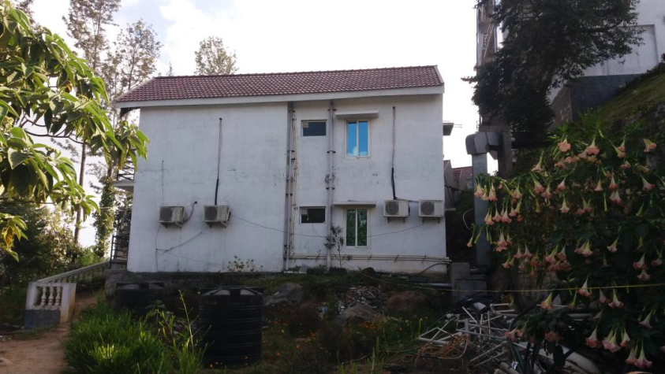
VACANT LAND
VL - 002
Location of Property | YERCAUD
Total area of Plot | 1651 sq.ft
Constructed area | NA
Year of construction | NA
Current market value | Rs. 24.75 lacs

Slide 3
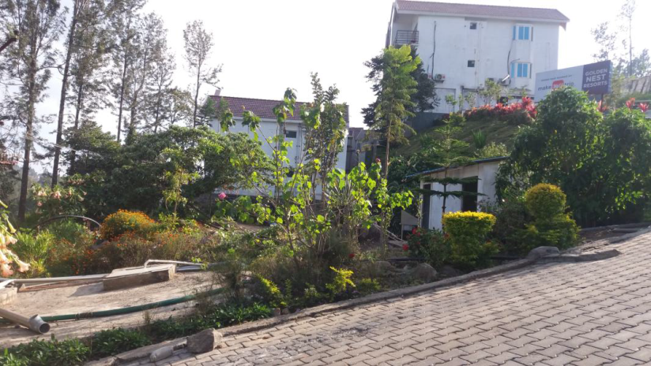
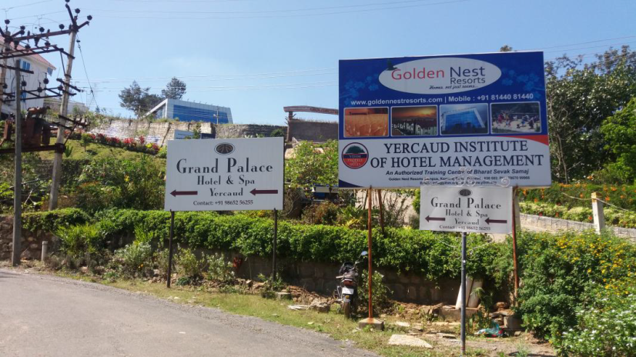
VACANT LAND
VL - 003
Location of Property | YERCAUD
Total area of Plot | 2844 sq.ft
Constructed area | NA
Year of construction | NA
Current market value | Rs. 42.65 lacs

Slide 4
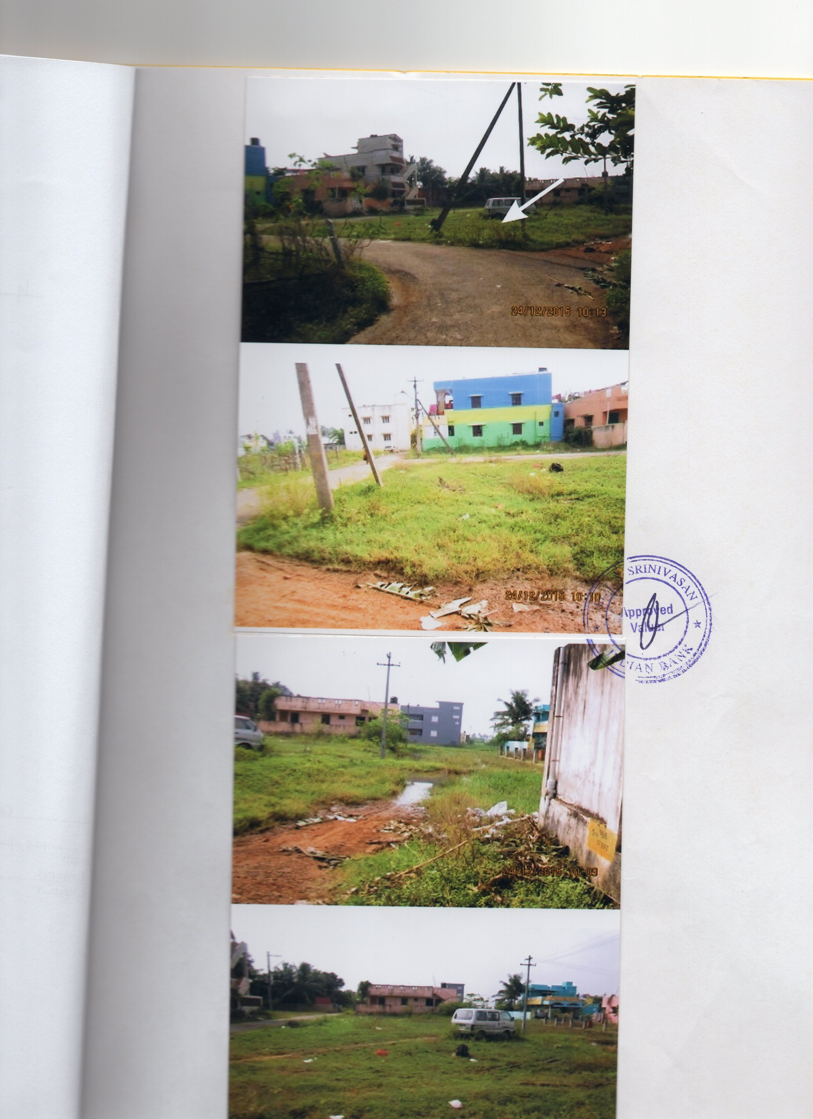
VACANT LAND
VL - 004
Location of Property | TENDRAL NAGAR THIRUVALLUR
Total area of Plot | 1022 sq.ft
Constructed area | NA
Year of construction | NA
Current market value | Rs. 11.24 lacs

Slide 5
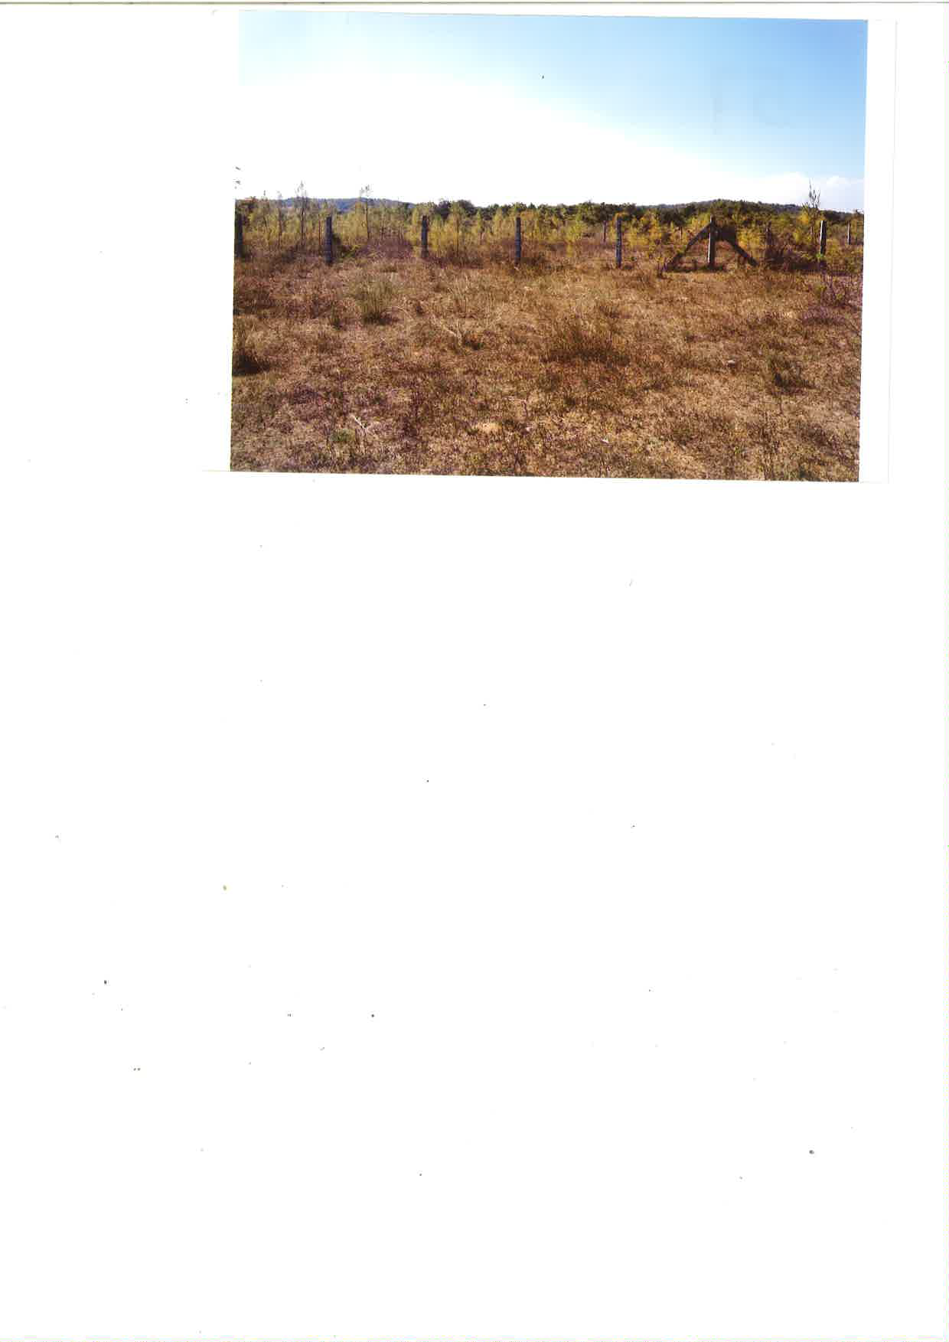
VACANT LAND
VL - 005
Location of Property | OTHIVAKKAM,CHENGALPET
Total area of Land | 1.09 Acres
Constructed area | NA
Year of construction | NA
Current market value | Rs.27.00 lacs

Slide 6
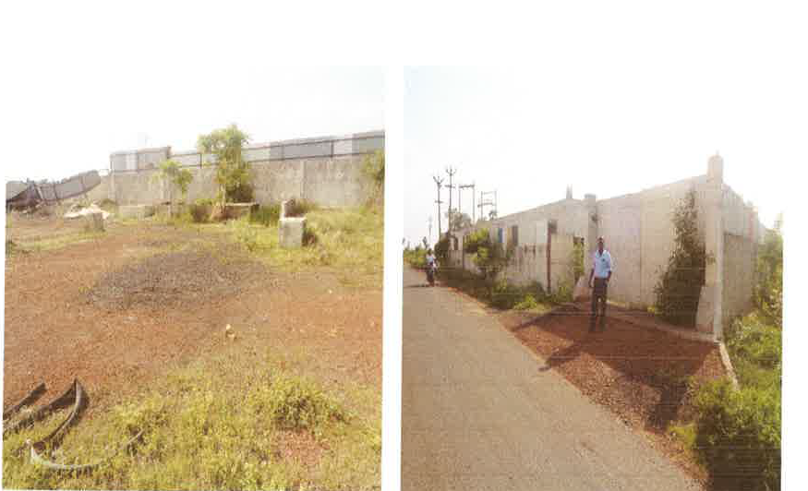
VACANT LAND
VL- 006
Location of Property | NOMALLUR,THIRUVALLUR
Total area of land | 50 CENTS
Constructed area | NA
Year of construction | NA
Current market value | Rs. 20.00 lacs

Slide 7
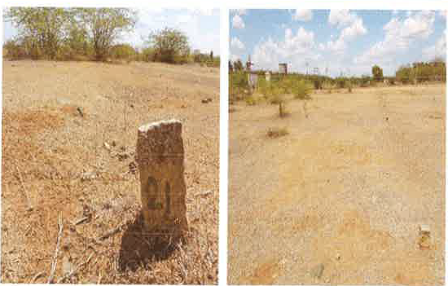
VACANT LAND
VL - 007
Location of Property | KOLATHUR CHENNAI
Total area of land | 67505 sq.ft
Constructed area | NA
Year of construction | NA
Current market value | Rs. 20.25 lacs

Slide 8
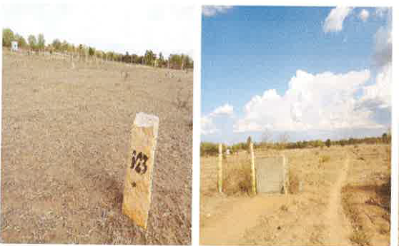
VACANT LAND
VL - 008
Location of Property | KODAIKAL, VELLORE
Total area of land | 75934 sq.ft
Constructed area | NA
Year of construction | NA
Current market value | Rs. 26.57 lacs

Slide 9
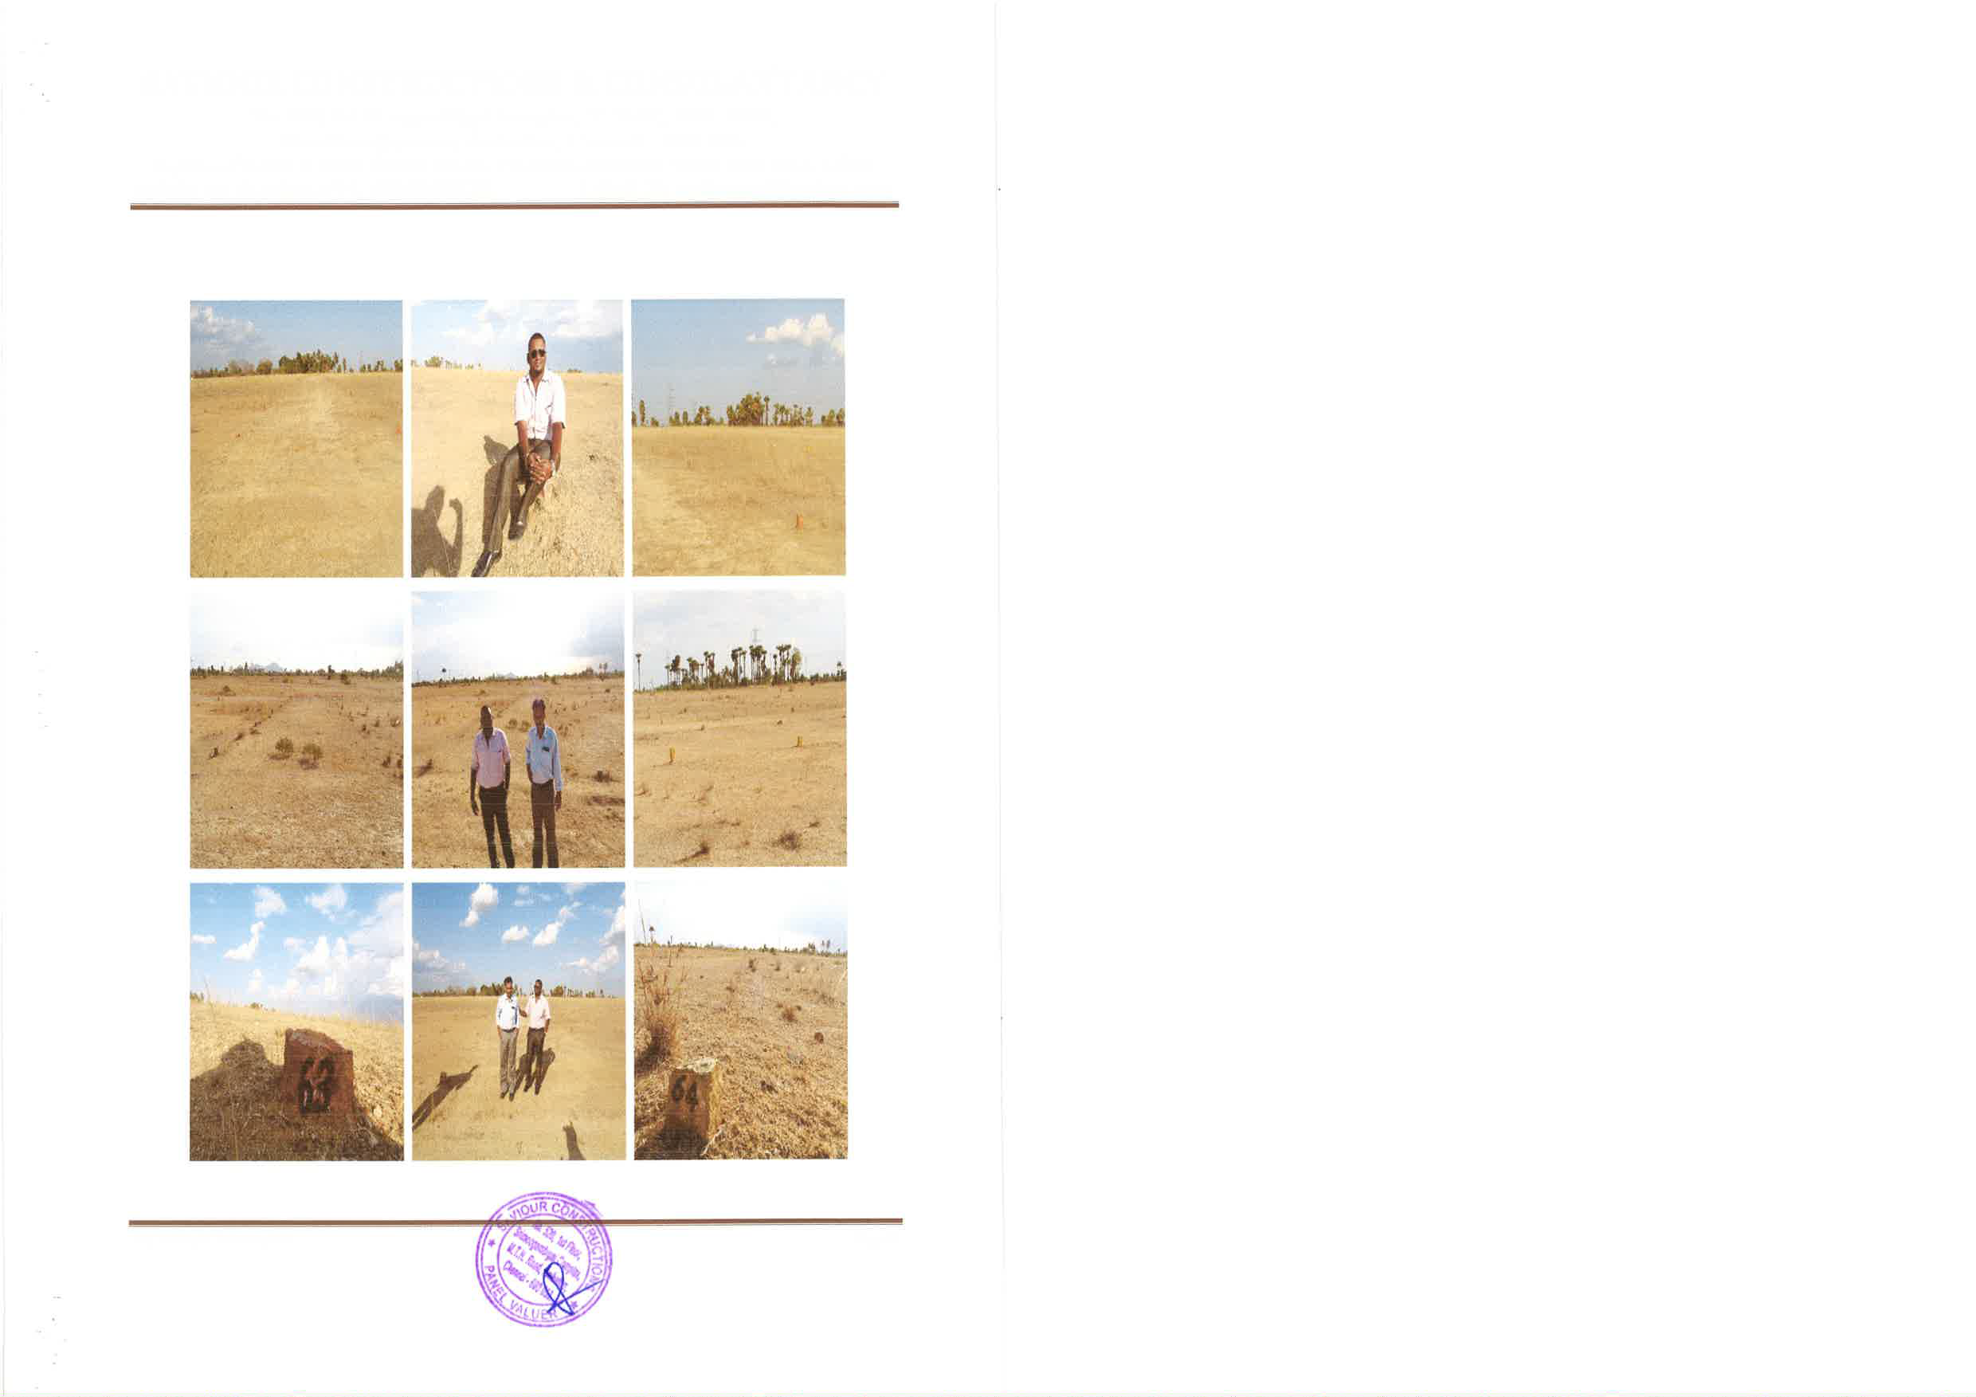
VACANT LAND
VL - 009
Location of Property | ADYAL, VELLORE
Total area of land | 1,02,000 sq.ft
Constructed area | NA
Year of construction | NA
Current market value | Rs. 42.84 lacs

Slide 10
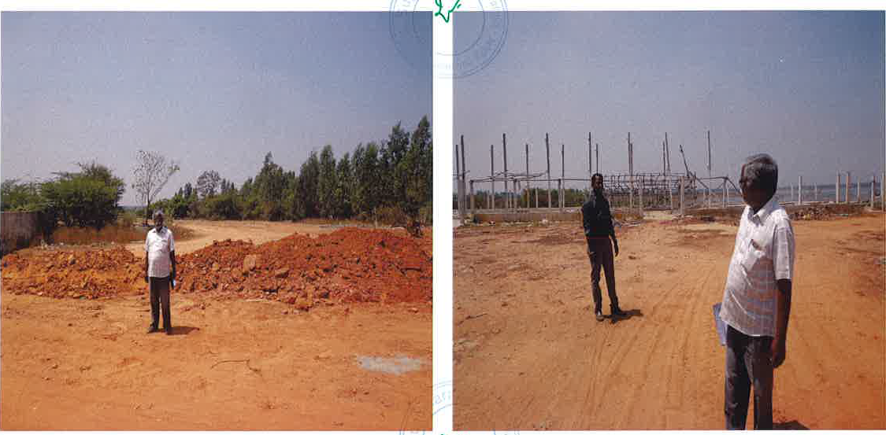
VACANT LAND
VL - 010
Location of Property | THIRUVALLUR
Total area of land | 1.68 Acres
Constructed area | NA
Year of construction | NA
Current market value | Rs. 243.60 lacs

Slide 11
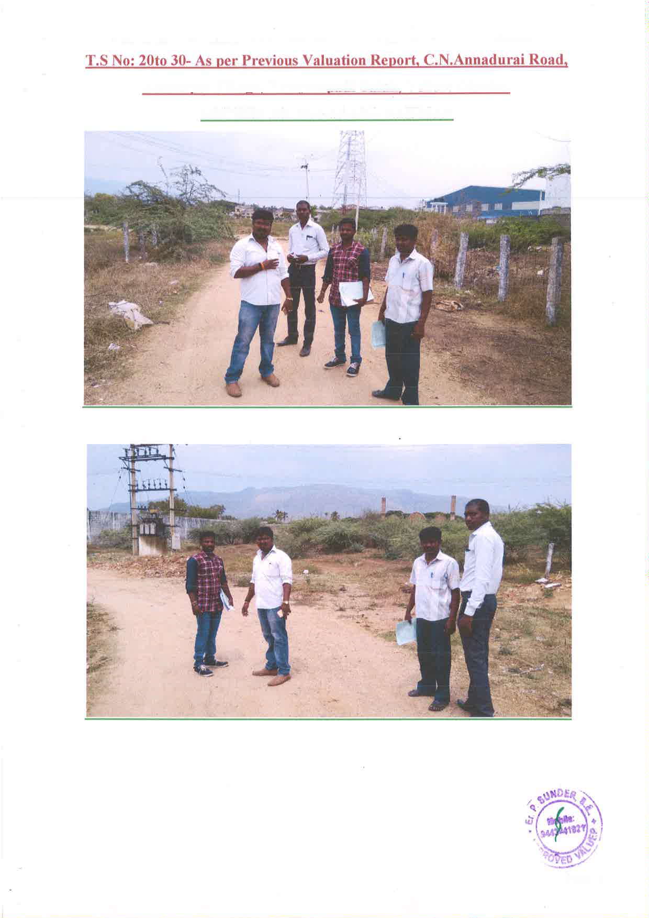
VACANT LAND
VL - 011
Location of Property | VANIYAMBADI, VELLORE
Total area of land | 1.17 Acres
Constructed area | NA
Year of construction | NA
Current market value | Rs. 64.35 lacs

Slide 12
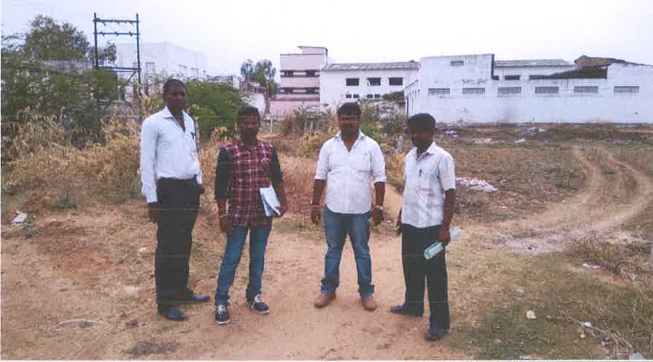
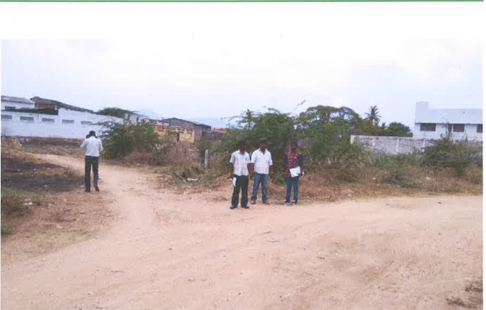
VACANT LAND
VL - 012
Location of Property | VANIYAMBADI,VELLORE
Total area of land | 25.75 CENTS
Constructed area | NA
Year of construction | NA
Current market value | Rs. 15.45 lacs

Slide 13
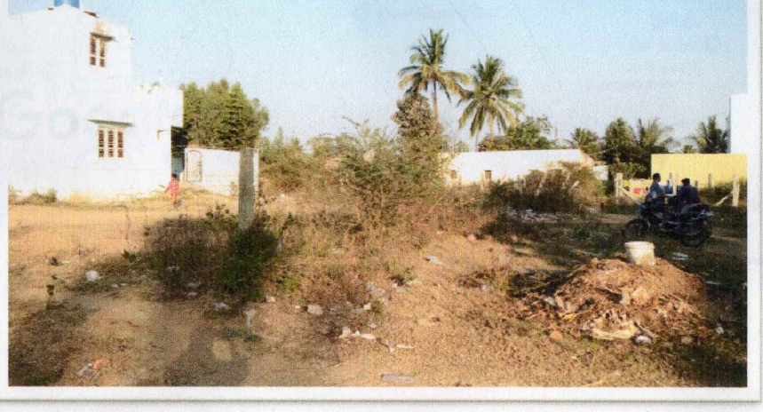

VACANT LAND
VL - 013
Location of Property | HOSUR,KRISHNAGIRI
Total area of land | 1305 sq.ft
Constructed area | NA
Year of construction | NA
Current market value | Rs. 6.52lacs

Slide 14
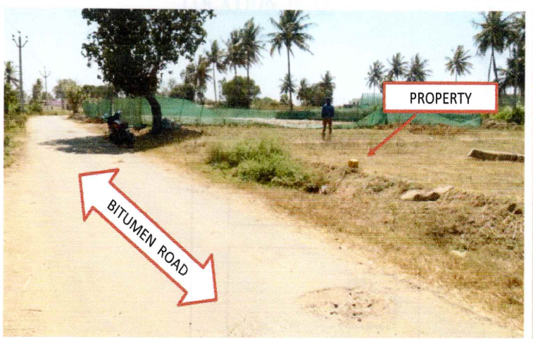

VACANT LAND
VL - 014
Location of Property | HOSUR,KRISHNAGIRI
Total area of land | 3538.94 sq.ft
Constructed area | NA
Year of construction | NA
Current market value | Rs. 21.23 lacs

Slide 15
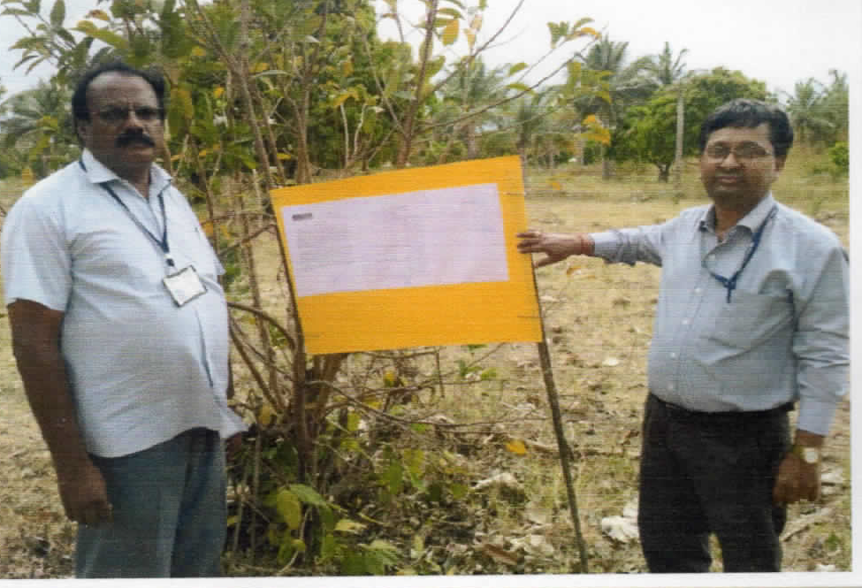
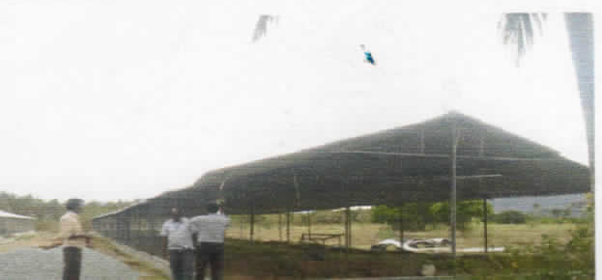
VACANT LAND
VL - 015
Location of Property | PALACODE, DHARMAPURI
Total area of land | 8.25 Acre
Constructed area | NA
Year of construction | NA
Current market value | Rs. 65.06 lacs

Slide 16
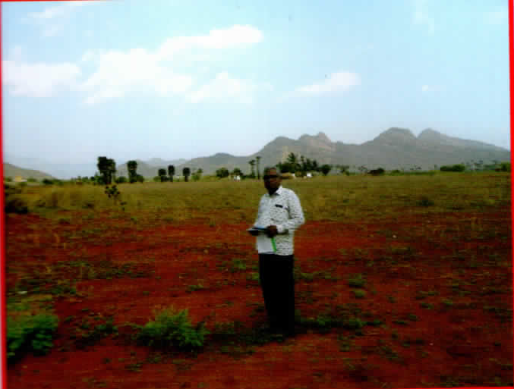
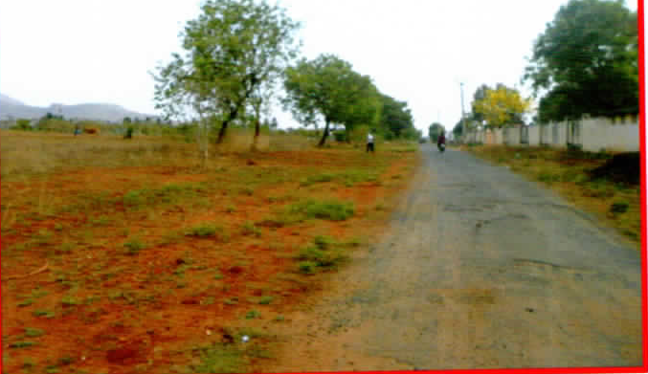
VACANT LAND
VL - 016
Location of Property | NAMAKKAL
Total area of land | 47245 sq.ft
Constructed area | NA
Year of construction | NA
Current market value | Rs. 37.80 lacs

Slide 17
VACANT LAND
VL - 017
Location of Property | RAMAPURAM, CHENNAI
Total area of land | 2560 sq.ft
Constructed area | VACCANT LAND
Year of construction | NA
Current market value | Rs. 102.40 lakh
Sale value | Rs. 92.16 lakh

Slide 18
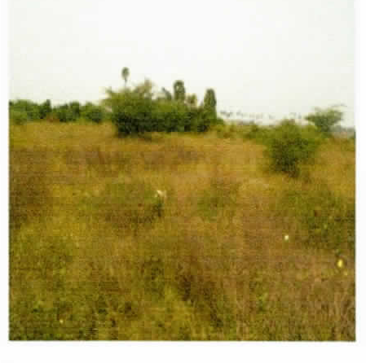
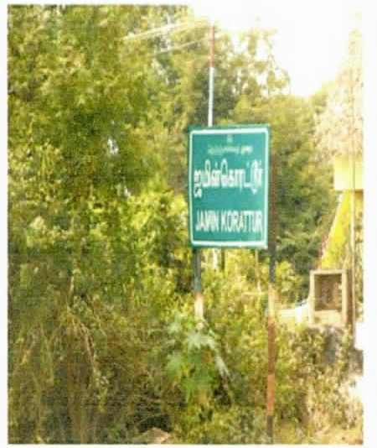
VACANT LAND
VL - 018
Location of Property | ZAMIN KORATTUR VILLAGE TIRUVALLUR DISTRICT (OPP TO INTERNATIONAL MARITIME UNIVERSITY)
Total area of land | 26563.00 sq.ft
Constructed area | Vacant Land
Year of construction | NA
Current market value | Rs. 212.00 lacs
Sale value | Rs. 169.00 lacs

Slide 19
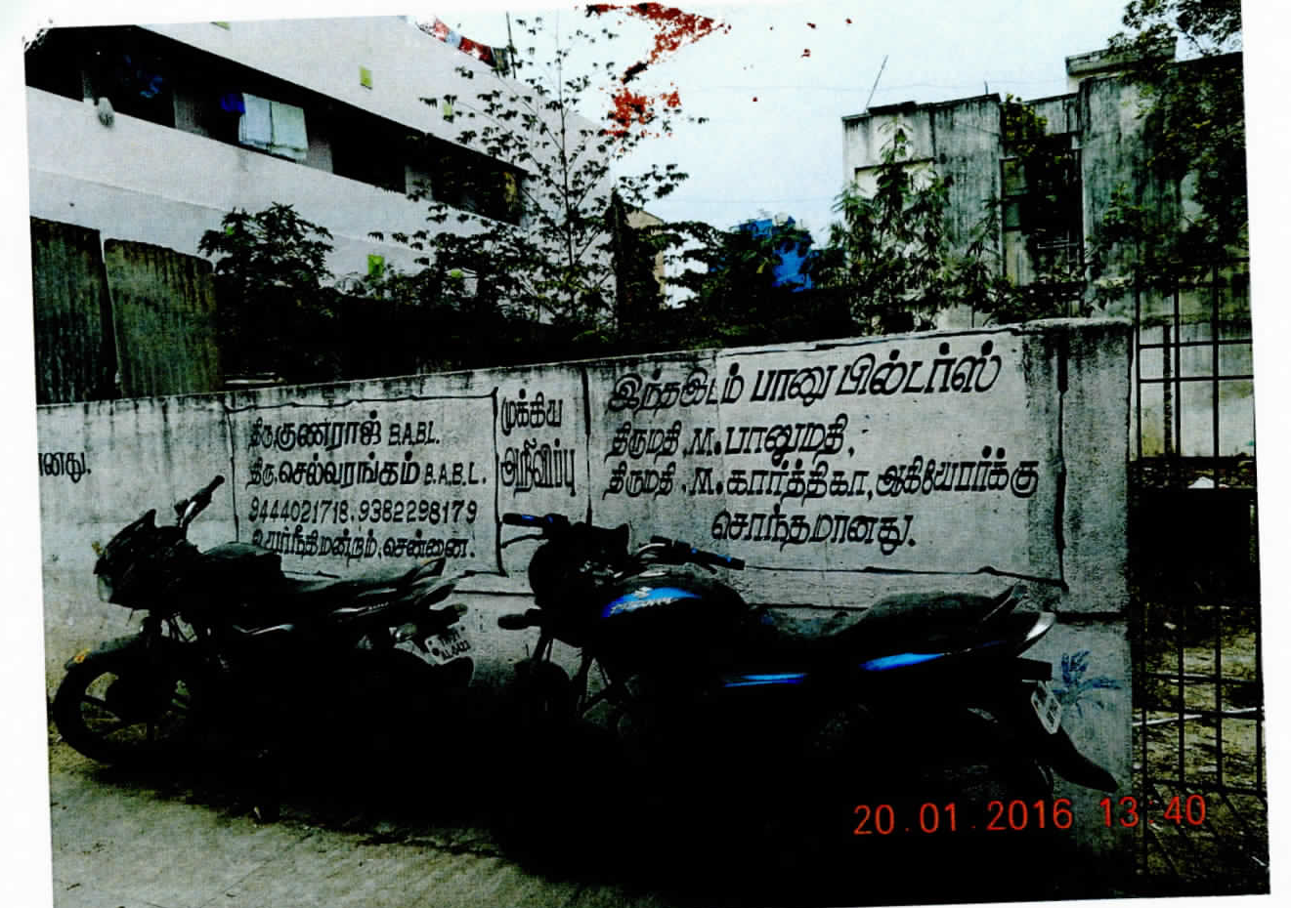
VACANT LAND
VL - 019
Location of Property | PERAMBUR CHENNAI
Total area of land | 3000 sq.ft as per Doc. 2996 sq.ft as per Patta
Constructed area | Vacant Land
Year of construction | NA
Current market value | Rs. 124.33 lacs
Sale value | Rs. 87.03 lacs

Slide 20
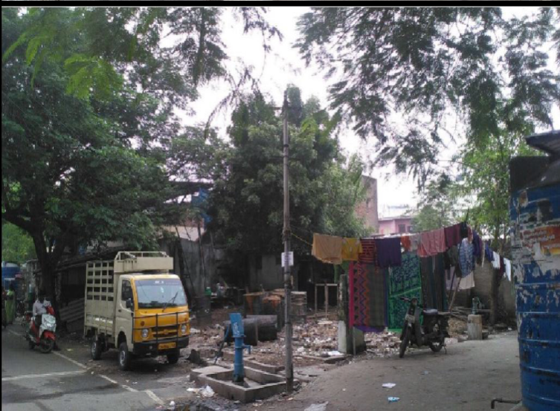
VACANT LAND
VL - 020
Location of Property | ASHOK NAGAR CHENNAI
Total area of land | 1108 sq.ft
Constructed area | Vacant Land
Year of construction | NA
Current market value | Rs. 77.56 lacs
Sale value | Rs. 69.80 lacs

Slide 21
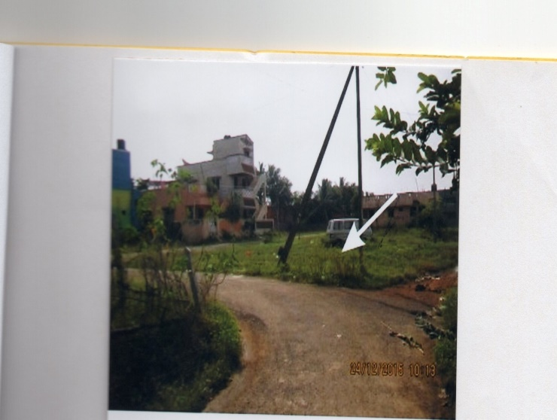
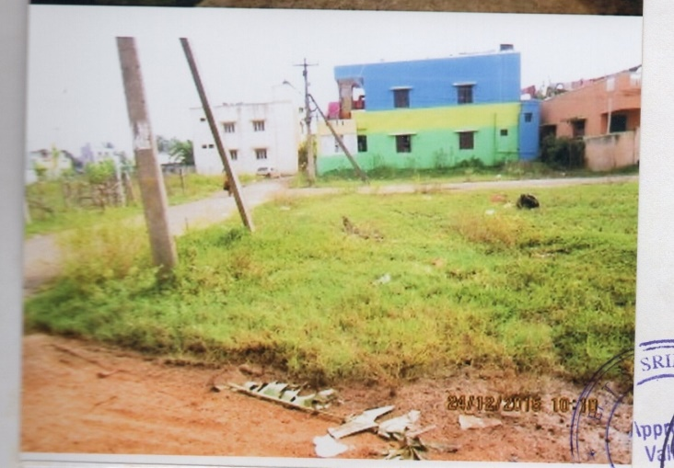
VACANT LAND
VL - 021
Location of Property | Thandurai Tiruvallur District
Total area of land | 1022 sq.ft
Constructed area | Vacant Land
Year of construction | NA
Current market value | Rs. 11.24 lacs
Sale value | Rs. 10.67 lacs

Slide 22
VACANT LAND
VL - 022
Location of Property | YELAHANKA HOBLI,BANGALURU
Total area of land | 1800 sq.ft
Constructed area | NA
Year of construction | NA
Current market value | 54.00 lacs

Slide 23
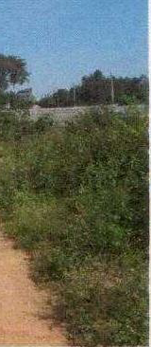
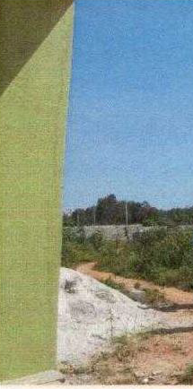
VACANT LAND
VL - 023
Location of Property | YESHVANTHAPURA HOBLI, BANGALURU
Total area of land | 1725 sq.ft
Constructed area | 1725 sq.ft
Year of construction | NA
Current market value | 24.15 lacs

Slide 24
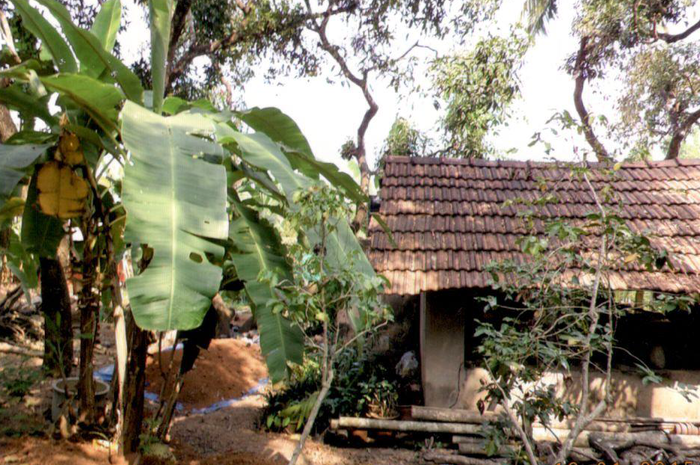
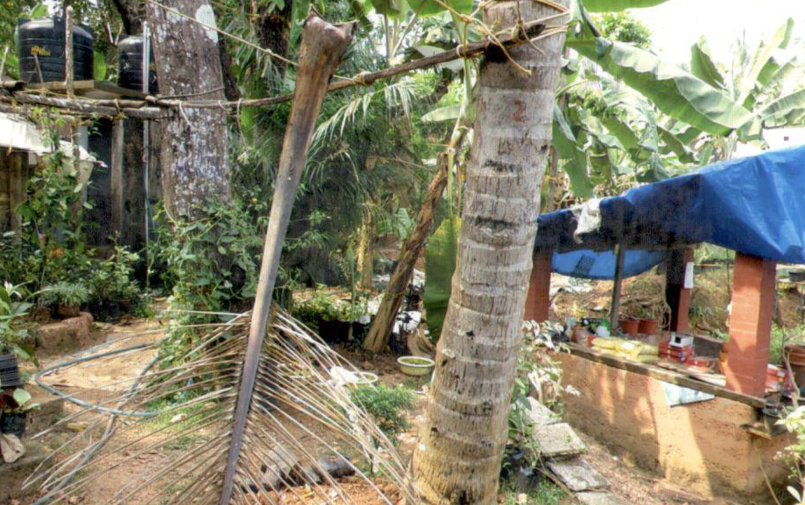
VACANT LAND
VL - 024
Location of Property | THALASSERY, KANNUR
Total area of land | 10 cents
Constructed area | NA
Year of construction | NA
Current market value | 50.00 lacs

Slide 25
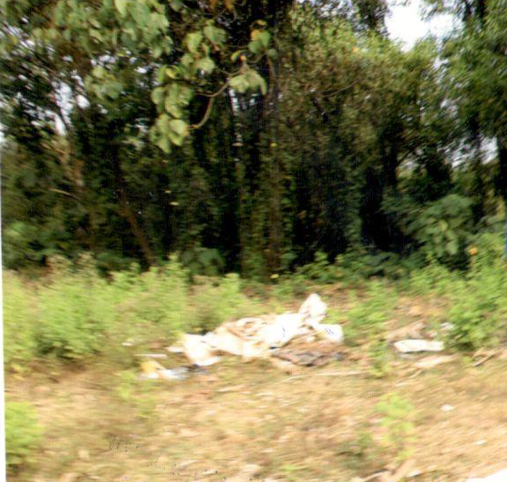
VACANT LAND
VL - 025
Location of Property | ELAYAVOOR, KANNUR
Total area of land | 03 cents
Constructed area | NA
Year of construction | NA
Current market value | 10.50 lacs

Slide 26
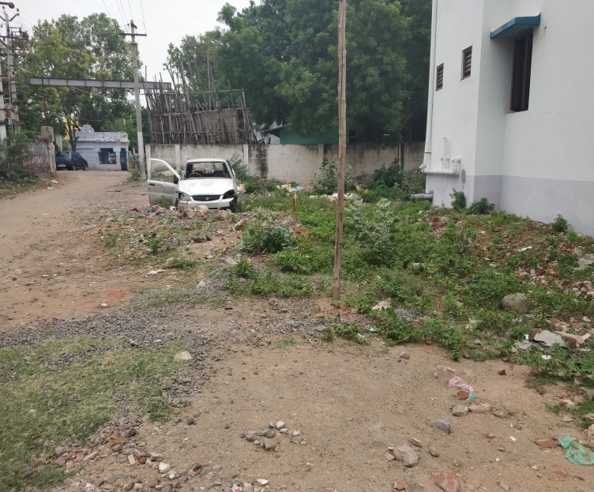
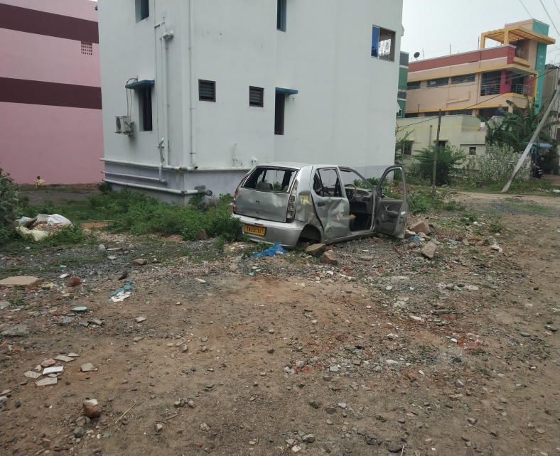
VACANT LAND
VL - 026
Location of Property | ARUMUGA GARDEN,TRICHY
Total area of land | 3624 sq.ft
Constructed area | VACANT LAND
Year of construction | ----
Current market value | Rs. 98.75 lacs

Slide 27
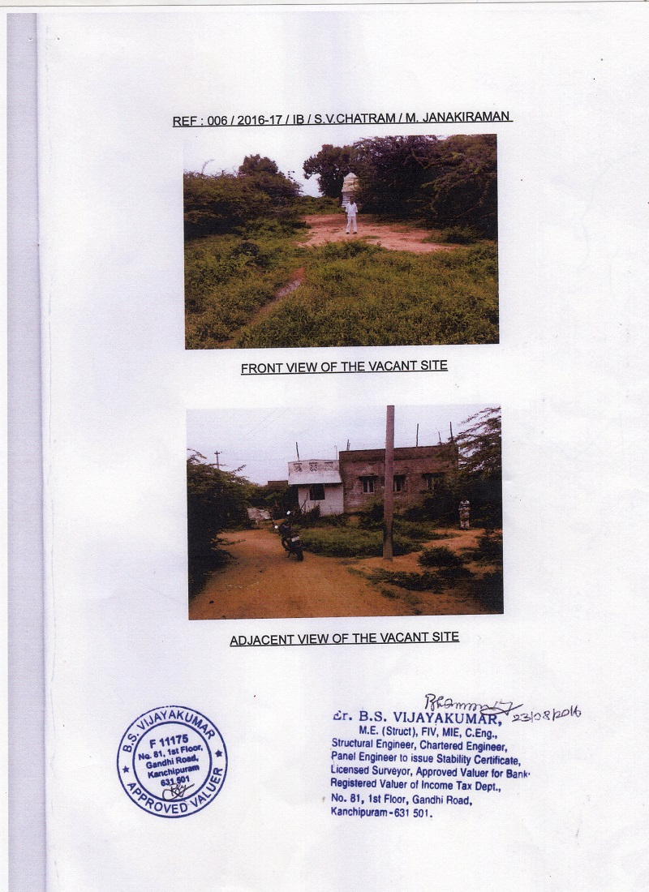
VACANT LAND
RESIDENTIAL BUILDING
VL - 027
Location of Property | KAANCHIPURAM
Total area of land | 4140 sq.ft
Constructed area | VACANT LAND
Year of construction | ----
Current market value | Rs. 10.50 lacs

Slide 28
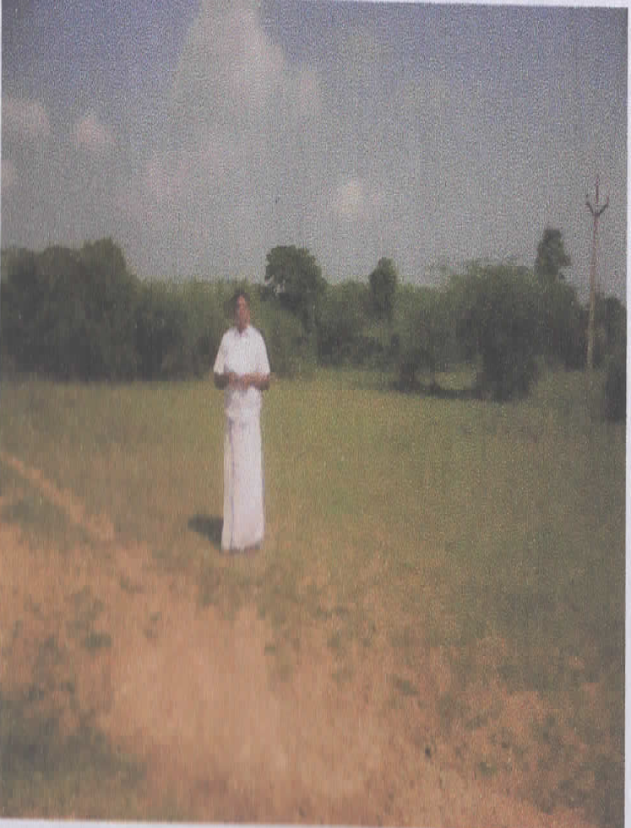
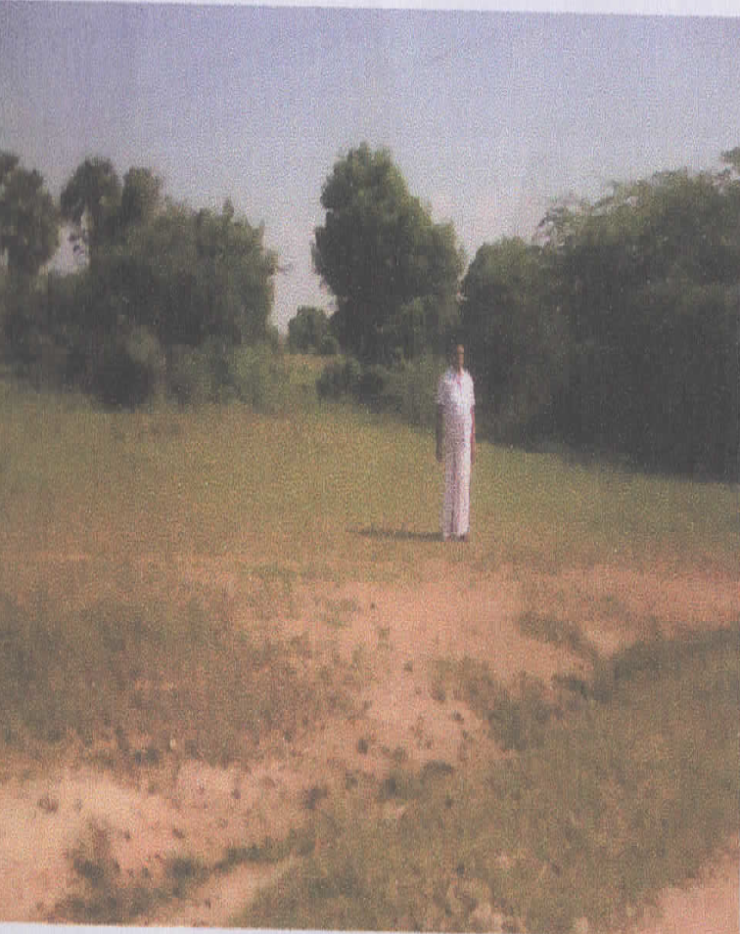
VACANT LAND
VL - 028
Location of Property | KAANCHIPURAM
Total area of land | 7412 sq.ft
Constructed area | VACANT LAND
Year of construction | ----
Current market value | Rs. 18.53 lacs

Slide 29
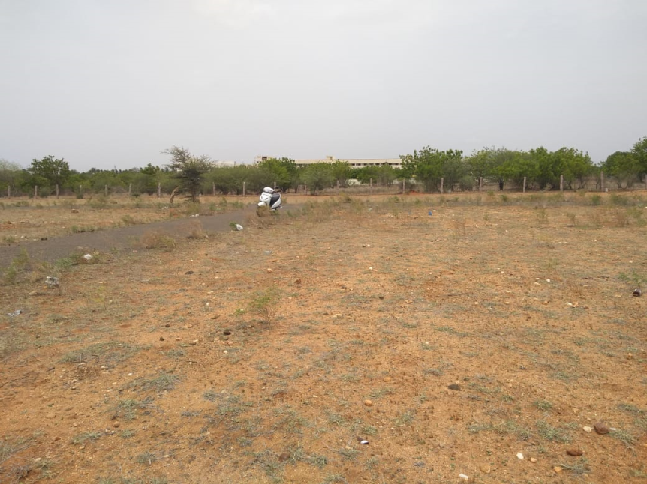
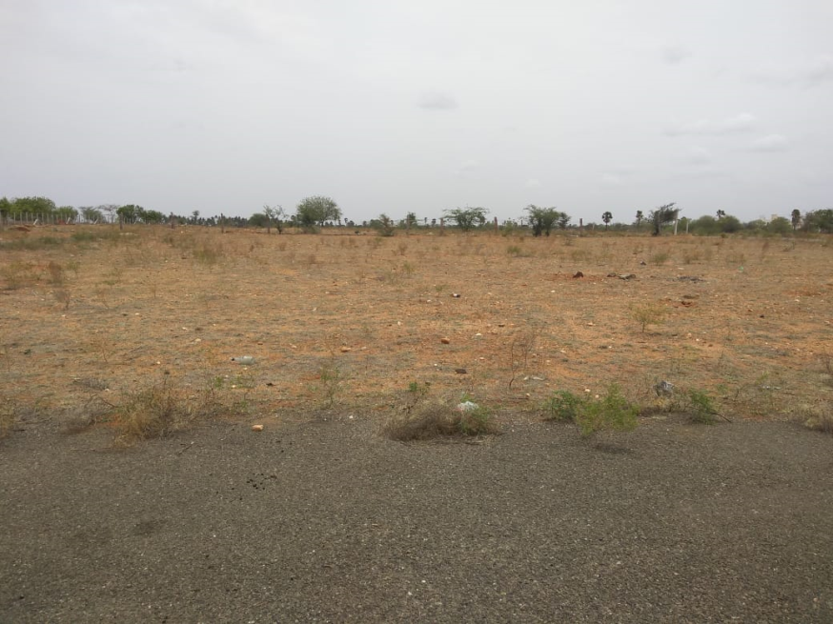
VACANT LAND
VL - 029
Location of Property | KARUR,TRICHY
Total area of land | 4735 sq.ft
Constructed area | Residential Plot
Year of construction | ----
Current market value | Rs. 68.65 lacs

Slide 30
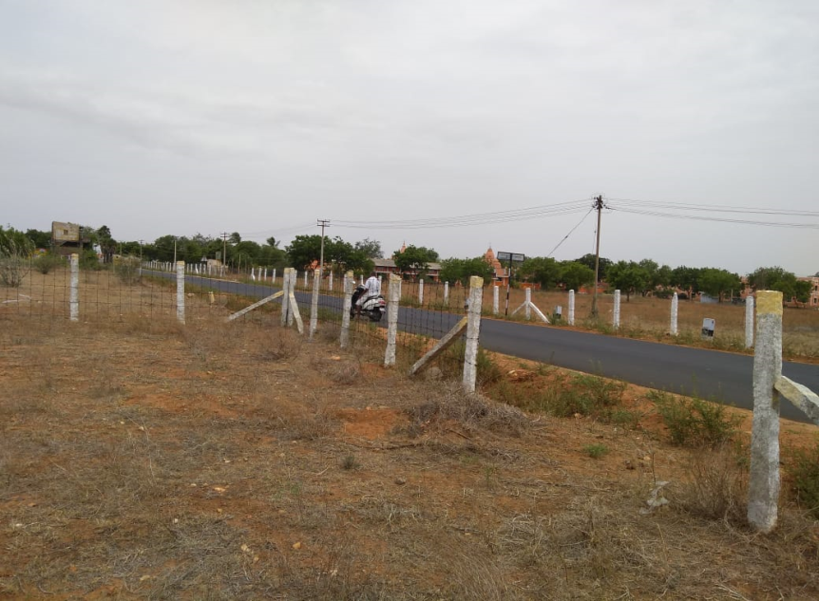
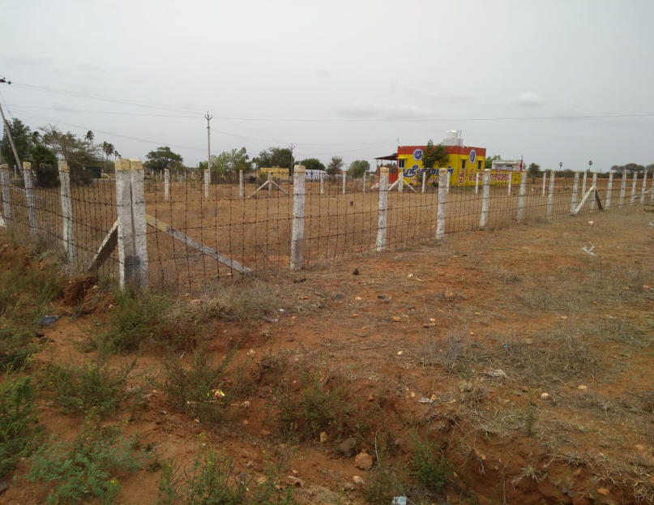
VACANT LAND
VL - 030
Location of Property | KARUR,TRICHY
Total area of land | 3300 sq.ft
Constructed area | Residential Plot No. 5&6
Year of construction | ----
Current market value | Rs. 33.00 lacs

Slide 31
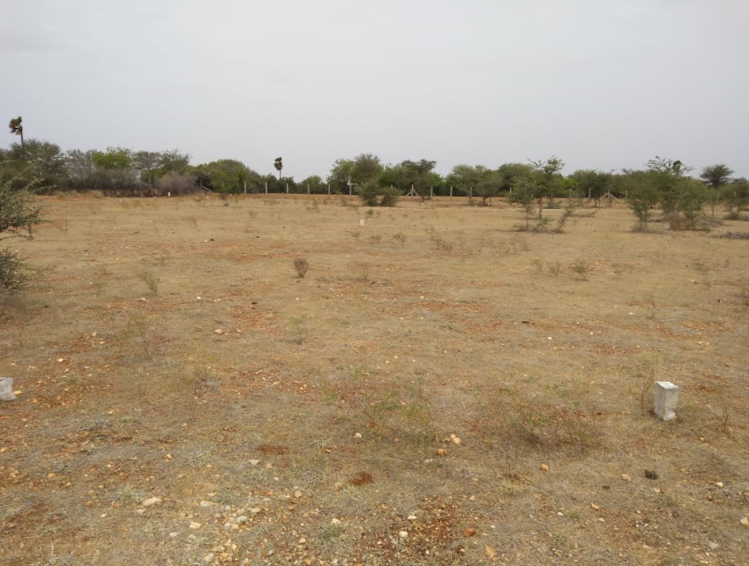
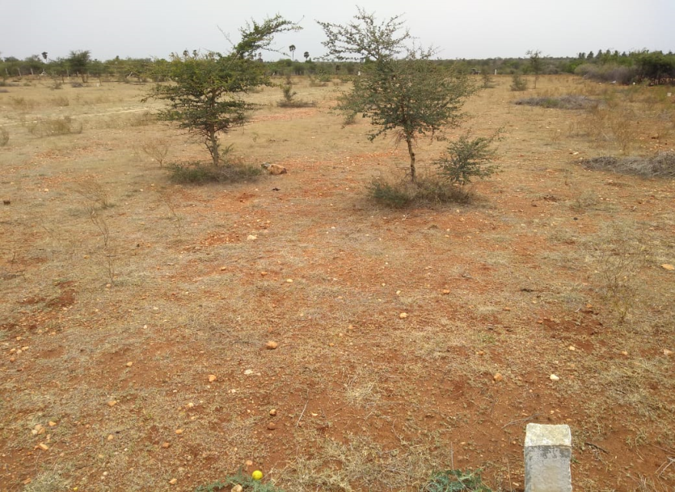
VACANT LAND
VL - 031
Location of Property | KARUR,TRICHY
Total area of land | 2400 sq.ft
Constructed area | Residential Plot
Year of construction | ----
Current market value | Rs. 15.60 lacs

Slide 32
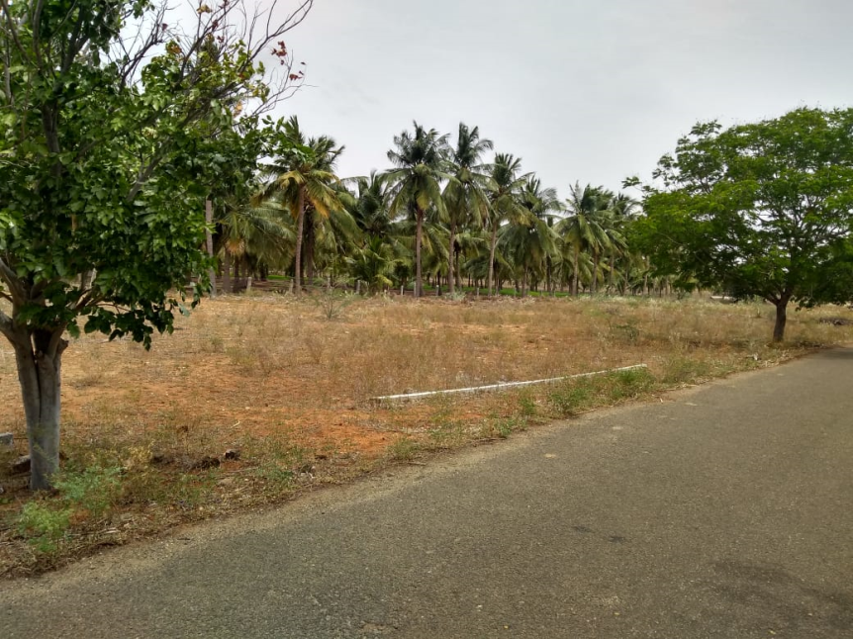
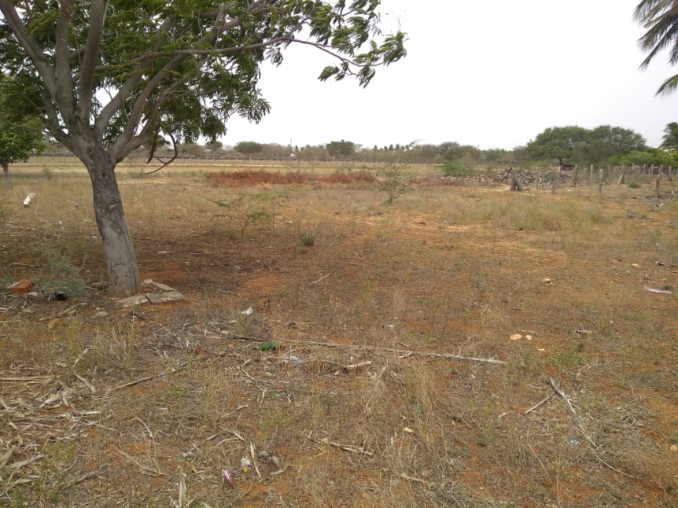
VACANT LAND
VL - 032
Location of Property | TRICHY
Total area of land | 4452.75 sq.ft
Constructed area | Plot no. 87,88,89 &90
Year of construction | ----
Current market value | Rs. 42.30 lacs

Slide 33
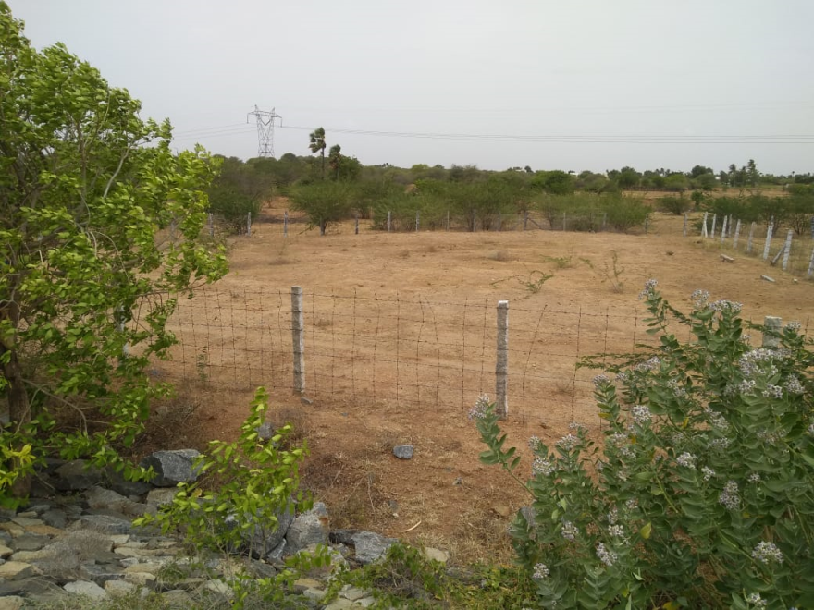
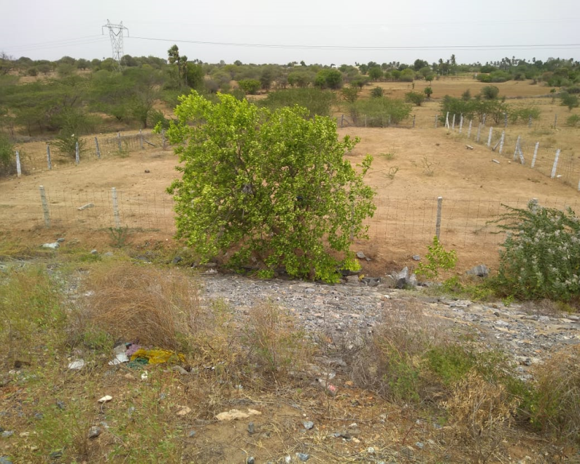
VACANT LAND
VL - 033
Location of Property | KARUR,TRICHY
Total area of land | 10900 sq.ft
Constructed area | Residential Plot
Year of construction | -----
Current market value | Rs. 196.20 lacs

Slide 34
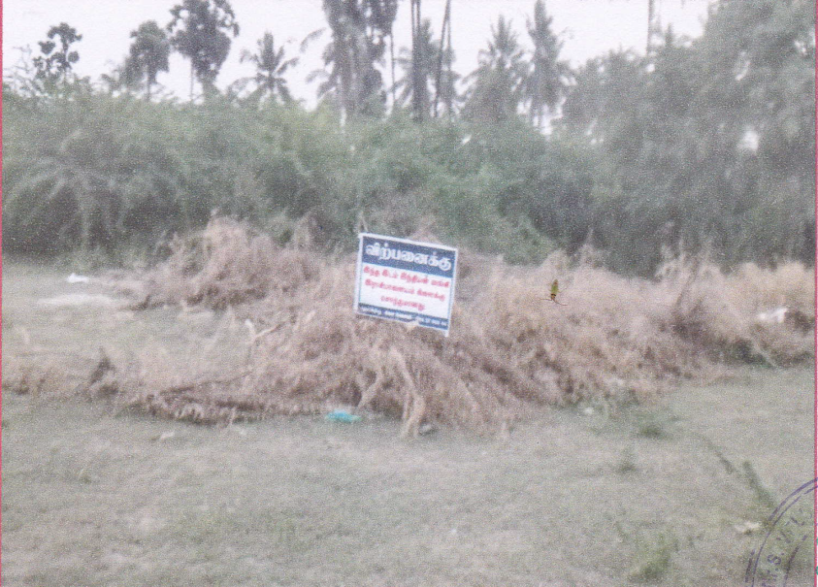
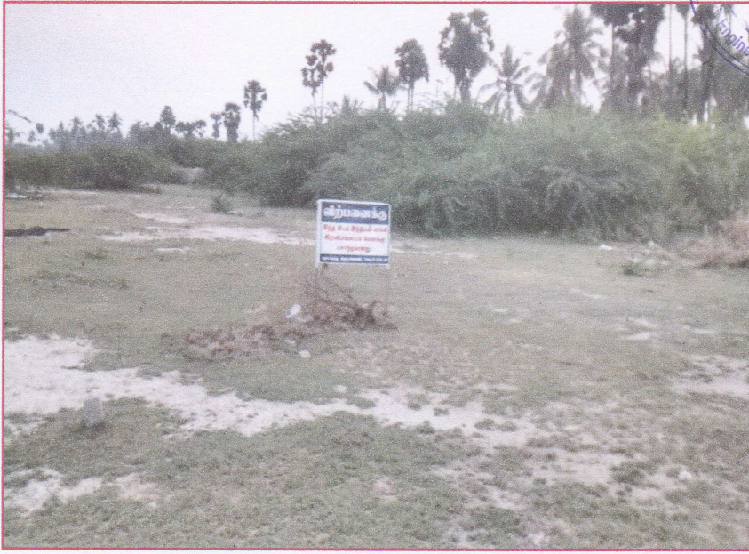
VACANT LAND
VL - 034
Location of Property | NAMAKKAL
Total area of land | 1380 sq.ft
Constructed area | ----
Year of construction | ----
Current market value | Rs. 4.83 Lacs

Slide 35
VACANT LAND
VL - 035
Location of Property | HOSUR,KRISHNAGIRI
Total area of land | 1305 sq.ft
Constructed area | NA
Year of construction | NA
Current market value | Rs. 6.52lacs

Slide 36


VACANT LAND
VL - 036
Location of Property | HOSUR,KRISHNAGIRI
Total area of land | 3.82 Acre
Constructed area | 47617 sq.ft
Year of construction | 2010
Current market value | Rs.285.59 lacs

Slide 37

VACANT LAND
RESIDENTIAL BUILDING
VL - 037
Location of Property | TIRUPPUR
Total area of land | 2.75 Acre
Constructed area | 0.68 Acre
Year of construction | 2014
Current market value | Rs.194.56 lacs

Slide 38


VACANT LAND
VL - 038
Location of Property | NALLAMBAKKAM VILLAGE GUDUVANCHERRY
Total area of land | 3 acres.
Constructed area | VACANT LAND
Year of construction
Current market value | 7.50 crores
Sale value | 6.75 crores

Slide 39


VACANT LAND
VL - 039
Location of Property | PERUNGUDI, CHENNAI
Total area of land | 4031 sq.fts
Constructed area | NA
Year of construction | NA
Current market value | Rs. 161.24 lacs

Slide 40

VACANT LAND
VL - 040
Location of Property | DHARMAPURI,
Total area of land | 19362.30 sq.fts
Constructed area | NA
Year of construction | NA
Current market value | Rs. 50.34 lacs

